Slide 1
Causal Tempo Tracking of Audio
5th International Conference on Music Information Retrieval
ISMIR 2004
Matthew E. P. Davies and Mark D. Plumbley
Presenter: Mao-Yuan Kao
Date: Jan. 4, 2007

Slide 2
Introduction
The tempo tracking system is divided into two sections:
an onset analysis stage, used to derive a rhythmically meaningful
representation from the input audio,
followed by a beat matching algorithm using auto- and cross-correlative methods to generate short term predictions of future beats in the audio.
The algorithm is evaluated over a range of musical styles by comparing
the predicted output to beats tapped by a musician.

Slide 3
Introduction (cont.)
Our approach combines recent work on onset detection [2] with a beat
prediction method based on the autocorrelation function (ACF) of the
onset detection function.
While it has been suggested that the ACF would not be suitable for
beat tracking, due to the loss of phase information [14], we combine
this with a separate phase matching stage to recover the beat timings.

Slide 4
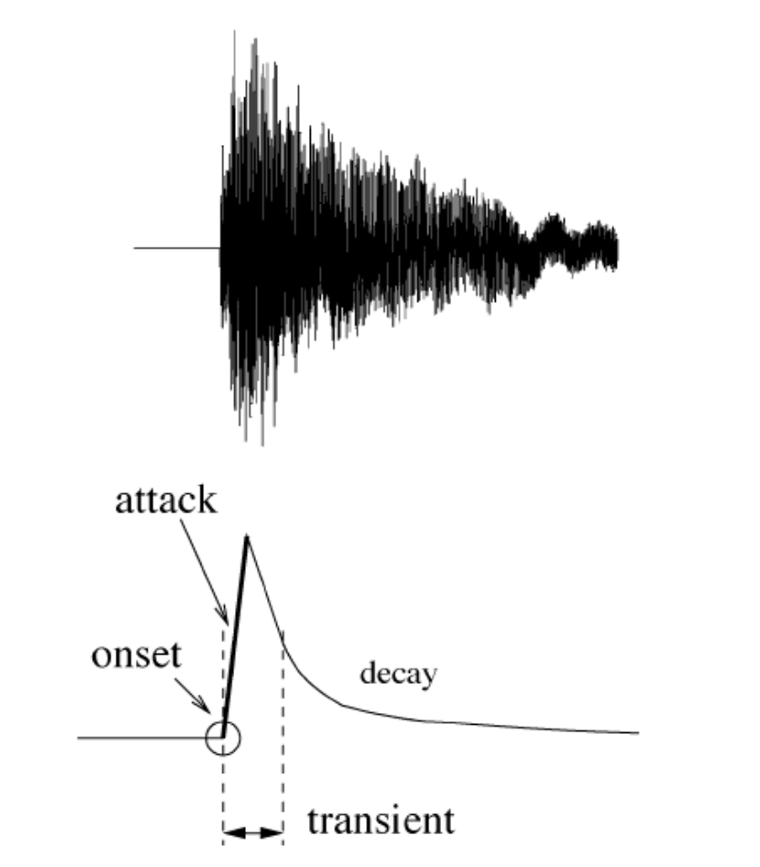
Onset
Note onset detection and localization is
useful in a number of analysis and
indexing techniques for musical signals.
The usual way to detect onsets is to
look for “transient” regions in the signal
“Attack,” “transient,” “decay,” and “onset”
in the ideal case of a single note.

Slide 5
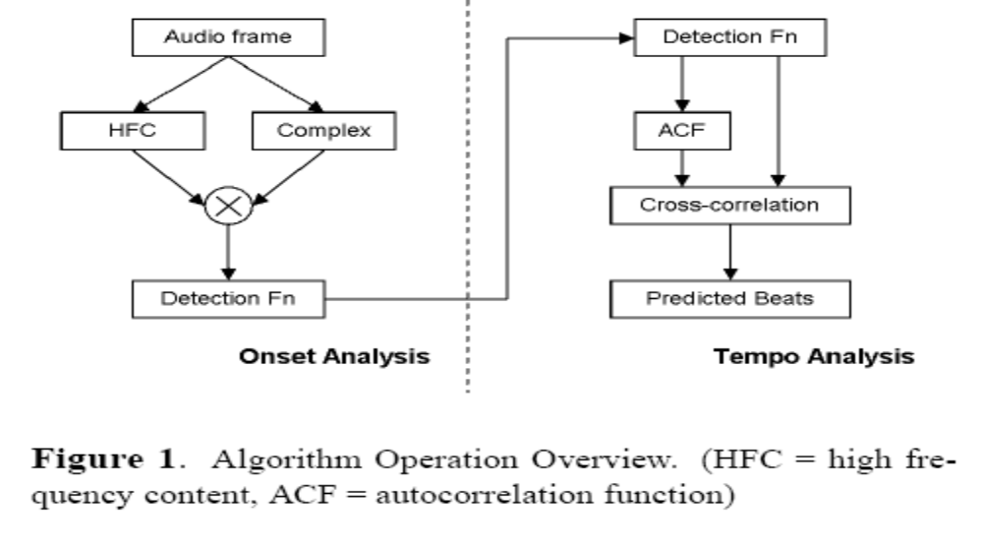
Onset Analysis
In system use two detection functions - an HFC [12] and a complex
domain approach [3] which are multiplied together to create a single
input for the tempo analysis stage (as shown in Figure 1).

Slide 6
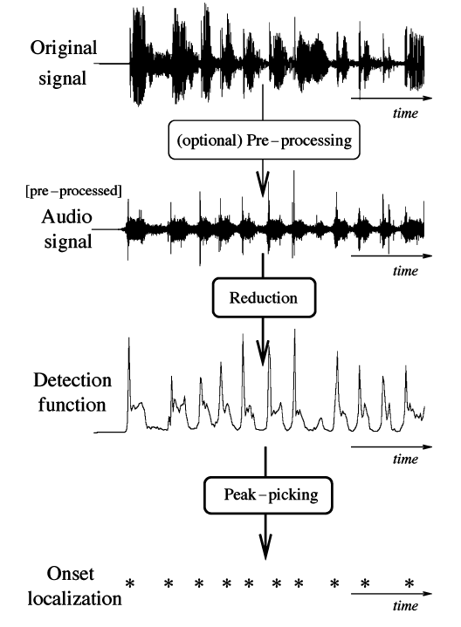
Flowchart of a standard onset detection algorithm

Slide 7

High Frequency Content (HFC)
[12] present an approach to energy based onset detection, using a
linear weighting corresponding to bin frequency k of the Short Time
Fourier Transform (STFT) frame X_{k}[n] of audio input x[n] to
emphasize the high frequency energy within the signal,
giving the detection function output df_{h}[n] given by:
This technique is particularly appropriate for emphasizing percussive
type onsets, most notably cymbals, where the transient region of the
instrument hit is mainly composed of energy at high frequencies.
the HFC approach is suited for signals with strong percussive content

Slide 8
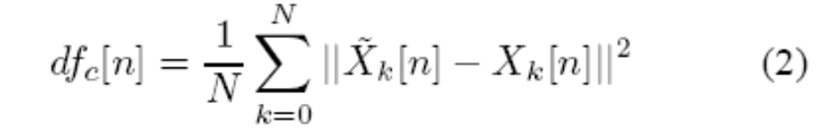
Complex Domain Onset Detection
HFC performs poorly when applied music with non-percussive onsets,
such as those created by a bowed violin.
We therefore incorporate a second detection function, as implemented
by [3] that is able to contend with a wider variety of signal types.
The complex detection function df_{c}[n] shown in equation (2) is a
combined energy and phase based approach to onset detection.

Slide 9

Tempo Analysis
Auto-correlation function (ACF)
The first stage in estimating the beat period is to calculate the ACF of the input detection function frame.
the peaks of the ACF will correspond to periodic events within the
signal at certain time lags, shown in Figure 2. The ACF, r_{df} , at lag, l,
is derived as follows:

Slide 10
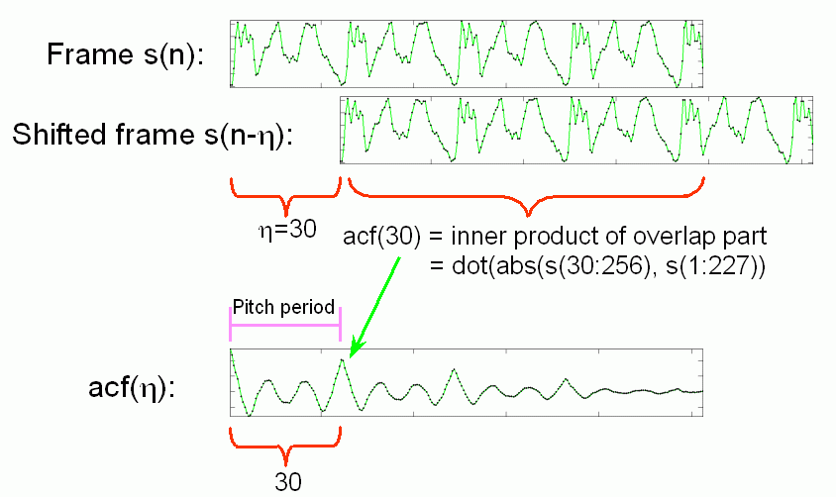
Auto-correlation function

Slide 11
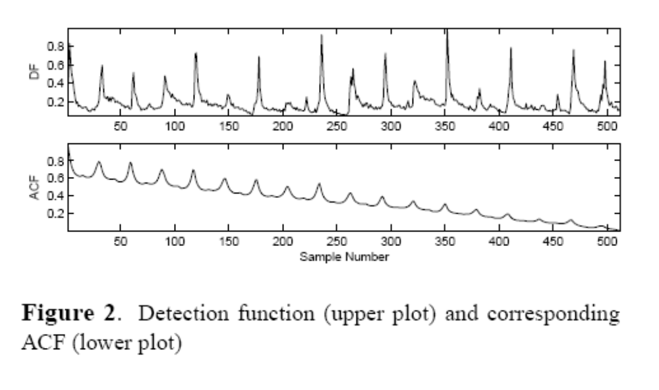
Tempo Analysis (cont.)

Slide 12

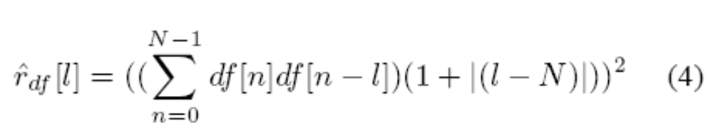
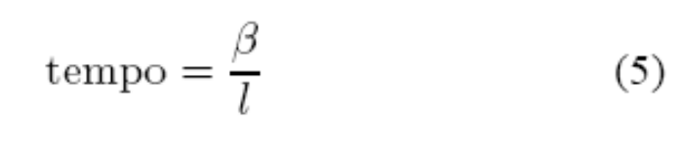
Tempo Analysis (cont.)
It is necessary to correct this so the analysis is not biased.
A modified ACF, , with the bias removed is calculated in equation (4).
the signal is squared to emphasize the peaks.
By selecting the lag of a particular peak in the ACF, an estimate of the
tempo can be made by applying equation (5), where β converts the
observed ACF lag l into the recognisable units of tempo: beats per
minute (bpm).

Slide 13
Beat Period Estimation
The inverse tempo-lag relationship results in poor tempo resolution at
short lags, meaning a single peak is often insufficient to obtain an
accurate value for the beat period.
Figure 2 shows the ACF has rhythmically related peaks at longer lags.
In a similar context to [5], greater accuracy can be achieved by extracting more
than one peak.
We combine four related lag observations from the ACF, and take
the mean to arrive at a value which compensates for the poor
resolution.
An efficient means to extract a number of arithmetically related events
from a signal (in this case rhythmically related lags from an ACF) is to
use a matrix-based comb filter approach [7].

Slide 14
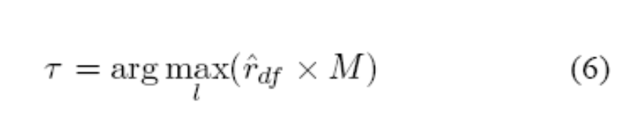

Beat Period Estimation (cont.)
Each filter is matched to a different fundamental beat period, covering
all lags in the range of 1 to 128 samples, where the maximal lag output
τ corresponds to the best matching beat period of the signal
frame:
where is a row vector of length N and M is an (N*L) matrix, with L as
the number of possible lags.

Slide 15

Lag Weighting Function
a range of possible weighting functions based on desired tempo output
responses, the most consistent results were obtained from an
empirically derived perceptual weighting using the Rayleigh distribution
function:
This gave a skewed response (shown in Figure 3) with a maximum at a
lag of 50 samples (where b = 50 in equation (7)) corresponding to the
preferred human tempo [8] of 100bpm.

Slide 16
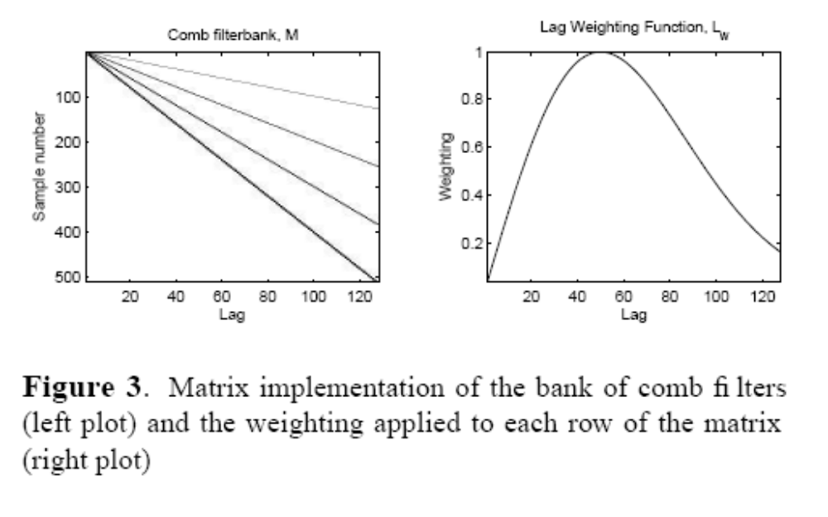
Lag Weighting Function (cont.)
it directly into the filterbank by multiplying each row of M by L_{w}[l] rather
than introduce unnecessary computation by weighting the ACF at each
iteration.

Slide 17
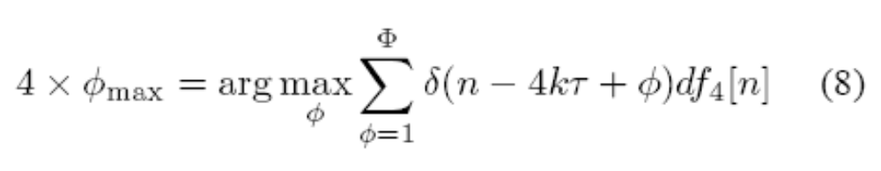
Beat Alignment
A search for the best matching beat alignment over all possible
shifts of the beat period (up to one whole period) is performed by cross-
correlation of the detection function with the comb filter matched to the
beat period.
In order to preserve the accuracy of the beat period, we need
subsample accuracy in the alignment process. We upsample the
detection function and the comb filter by a factor of 4, calculating an
offset ψ_{max} with respect to a reference point in the current detection
function frame:

Slide 18
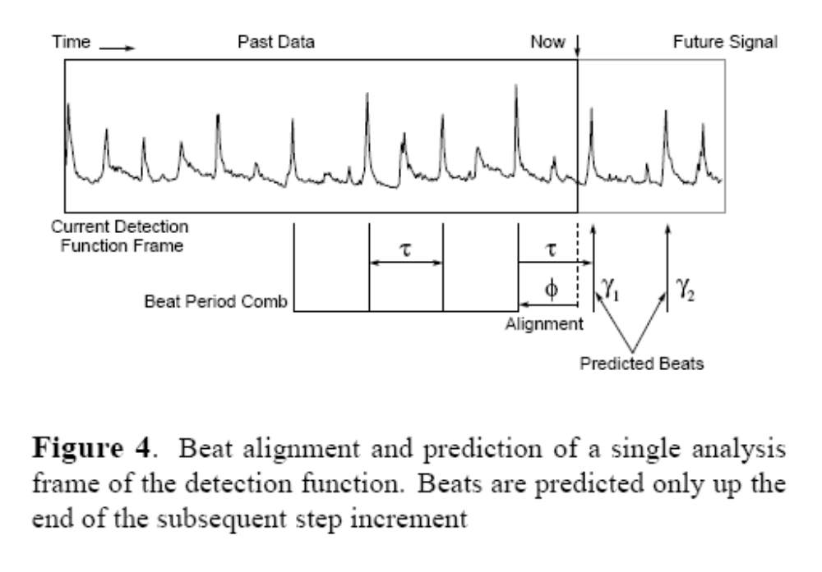
Beat Alignment (cont.)
where k = 1 : 4 (to make four peaks in the comb filter), τis the beat
period, ψrepresents the shifts up to one period and df₄[n] is the
upsampled detection function.

Slide 19
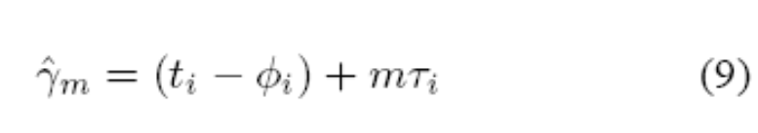
Beat Prediction
A graphical representation of the beat prediction process is given in
Figure 4, with the beat predictions calculated using the formula:
where is location of the m^{th} predicted beat in the subsequent
analysis frame (i + 1), t_{i} is the time at the end of frame i, with i, the
offset and i, the beat period of frame i.

Slide 20
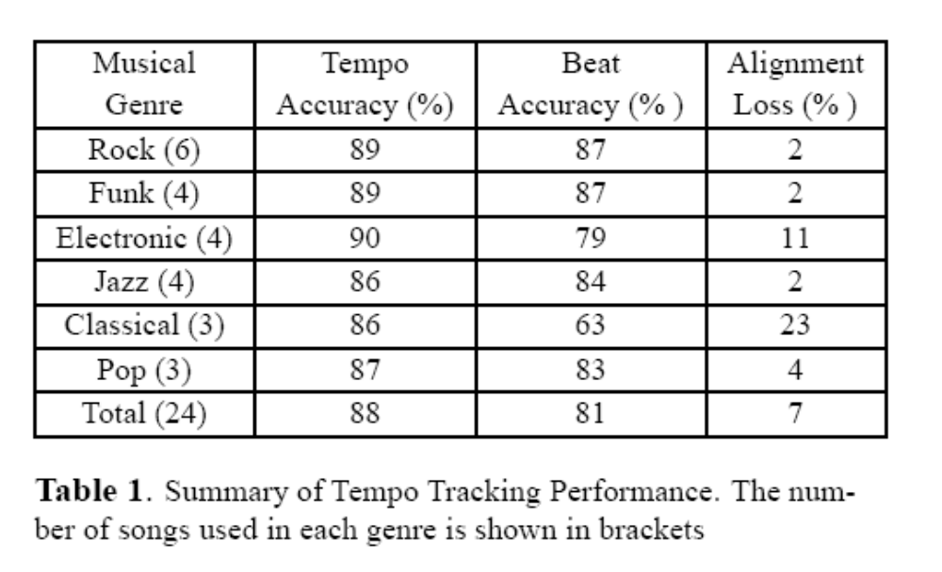
Results
The performance of the tempo tracking system was evaluated by
subjective comparison with beats tapped by a musician.

Slide 21
Complicated Beat Tracking Problems
The aim of this section was to test the robustness of the algorithm
when applied to a number of difficult test cases, The test cases
comprised a step tempo change, a ramp tempo change and an
expressive piano performance.
Subjective comparisons were made between the algorithm’s
performance and beats tapped by a musician.

Slide 22
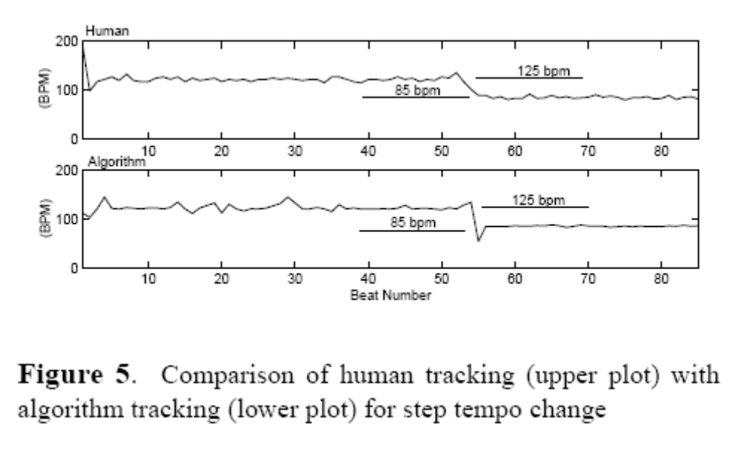
Step Tempo Change

Slide 23
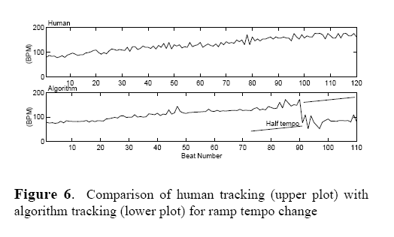
Ramp Tempo Change

Slide 24
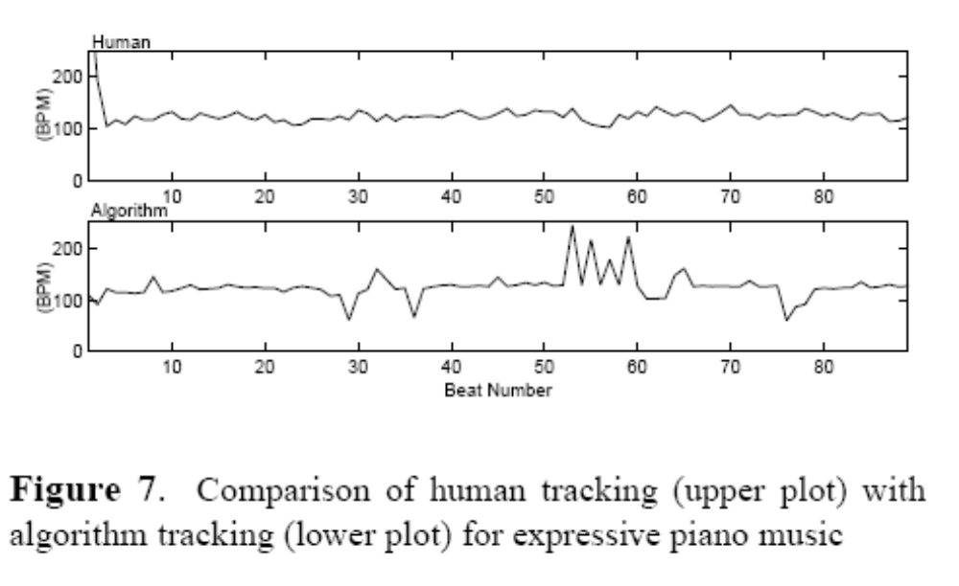
Expressive Piano Performance

Slide 25
References
[1] Allen P. E. and Dannenberg R. B. “Tracking Musical Beats in Real Time”, Proceedings of International Computer
Music Conference, pp. 140-143, 1990
[2] Bello J. P., Daudet L., Abdallah S., Duxbury C., Davies M. E. and Sandler M. B. “A Tutorial on Onset Detection in
Music Signals”, IEEETransactions on Speech and Audio Processing - accepted for publication, 2004
[3] Bello J.P., Duxbury C., Davies M.E. and Sandler M.B., “On the use of Phase and Energy for Musical Onset
Detection in the Complex Domain”, IEEE Signal Processing Letters, Vol 11, No. 6, pp 553-556, June 2004
[4] Brossier P., Bello J. P. and Plumbley M. D.“Real-time Temporal Segmentation of Note Objects in
Music Signals”, Proceedings of International Computer Music Conference, 2004
[5] Brown J. C. “Determination of the Meter of Musical Scores by Autocorrelation” Journal of
the Acoustical Society of America, Vol 94, No.4, 1993
[6] Dixon S. “Automatic Extraction of Tempo and Beat from Expressive Performances” Journal
of New Music Research, Vol 30, No. 1, March 2001
[7] Duxbury C. “Signal Models for Polyphonic Music” Ph.D. Thesis (submitted), Department
of Electronic Engineering, Queen Mary, University of London, 2004
[8] Fraisse P. “Rhythm and Tempo”, In D. Deutsch, editor, The Psychology of Music, Academic Press, 1982
[9] Goto M. and Muraoka Y. “Issues in Evaluating Beat Tracking Systems” Working Notes of IJCAI-97 Workshop on
Issues in AI and Music - Evaluation and Assessment, 1997
[10] Goto M. “An Audio-based Real-time Beat Tracking System for Music With or Without Drum-sounds” Journal of New
Music Research, Vol 30, No. 2, July 2001
[11] Laroche J. “Efficient Tempo and Beat Tracking in Audio Recordings” Journal of the Audio
Engineering Society, Vol 51, No. 4, 2003
[12] Masri P. and Bateman A. “Improved Modelling of Attack Transients in Music Analysis-Resynthesis” Proceedings of
International Computer Music Conference, pp. 100-103, 1996
[13] Raphael C. “Automated Rhythm Transcription” Proceedings of International Symposium
on Music Information Retrieval, pp. 99-107, 2001
[14] Scheirer E. D. “Tempo and Beat Analysis of Acoustic Musical Signals ” Journal of the Acoustical Society of
America, Vol 103, No. 1, 1998

